Slide 1
SR-DreamHome
- Aap Ka Soch – Aap Ka Sapna Ghar
Property recommendation application

Slide 2
Outline
Introduction
Current scenario
SR-DreamHome
Architecture
Functionality
Data source
Future work

Slide 3
Big Thanks!!!
Thanks to GoJek - Opportunity to submit in General Theme
Thanks to HackerEarth for providing platform.
Team:
Rama Mohan Rao D (Data Scientist at Bosch, India)
Sai Aravind Kashyap (Currently Pursuing Masters at IIIT, Bangalore)

Slide 4
Introduction
Property search – complex job
Huge options – variety of inputs to consider
Maturity required in mimicking buyer analysis
Lead time is quite high
Missing guidance on the search process
Heavy UI, many filters
Smart agents for understanding simple search statements

Slide 5
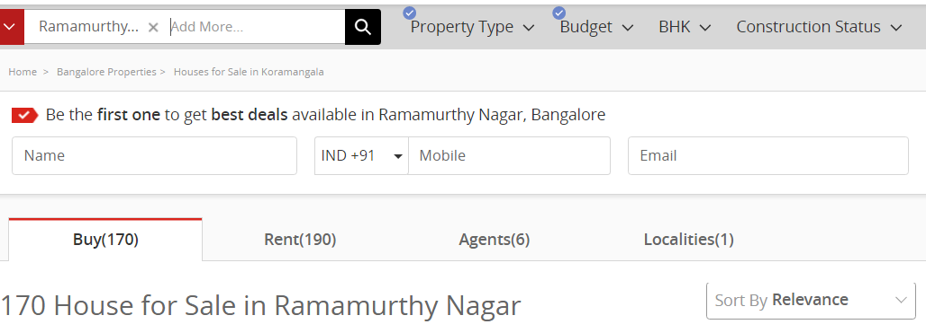

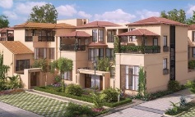
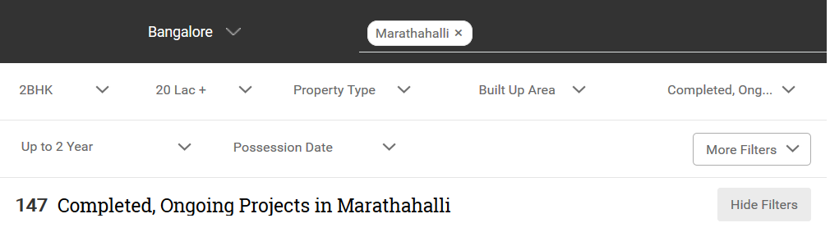
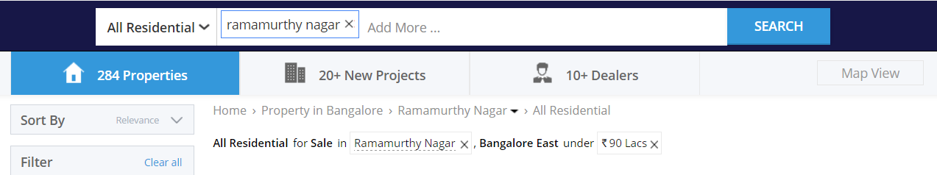
Current scenario
http://in.claseek.com/properties/landed-house/brigade-atmosphere-villas-for-sale_i60870
http://www.publicdomainpictures.net/

Slide 6


Current scenario
??
Plot vs House
Price vs sft
Worth Plot dimension?
Hyped vs reality
Locality, places
Rental income ?
Neighborhood ?
Appreciation
Worth Price ?
Area score ?
SR-DreamHome
Chat Bot for smart search
Min Price vs worth
Multistorey, similar
On Loan ?
best property ?
transaction ?
Availability ?
http://in.claseek.com/properties/landed-house/brigade-atmosphere-villas-for-sale_i60870
http://www.publicdomainpictures.net/

Slide 7
Visiting restaurants
Restaurants & Menu price
Restaurants & Food reviews
Decision
Recommendations
Home recommendation journey
Visiting Agencies
Portals & Houses
Rates
Location reviews, Indexes
??
Decision

Slide 8
SR-DreamHome
Giving buying score to a property for given buyer requirement
Supporting with right properties recommendations
Automatic updating considering new listed properties
Recommending/mapping prosperity buyers for Seller and vice versa
Smart validation of property details
Chat Agent in understanding simple statements and shows right properties

Slide 9
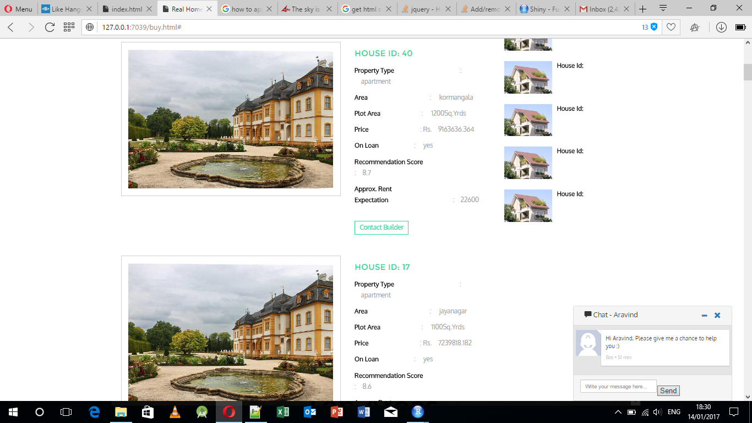
SR-DreamHome Glimpse

Slide 10
Score Calculation
Buying score
Property type
Location score
Plot Price
Multistorey/Independent
Price vs similar list
Availability
Neighborhood
Rental Input
Direction
Loan & Oths

Slide 11



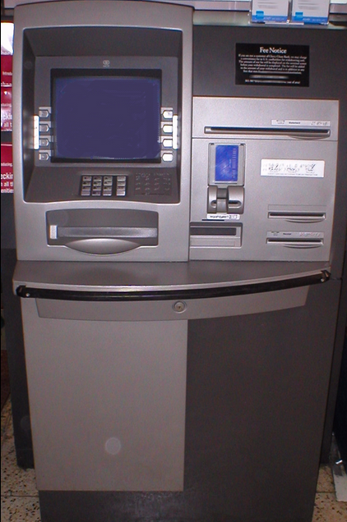


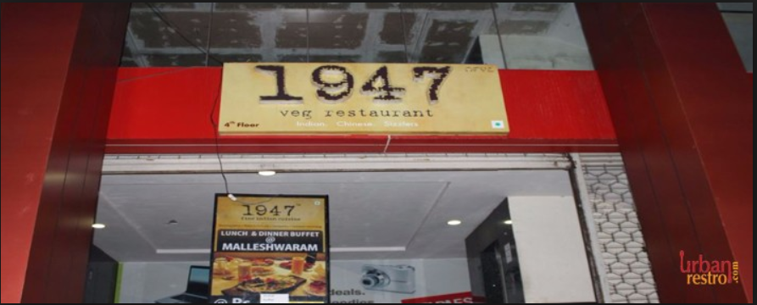
Score Calculation Contd...
Neighbourhood
Rental
Type
Rental Properties
Property type
Plot Price
Price
Plot
price sft
Price
Similar
Features
Condition
Age
Floors
Loan
Transaction
https://en.wikipedia.org/

Slide 12



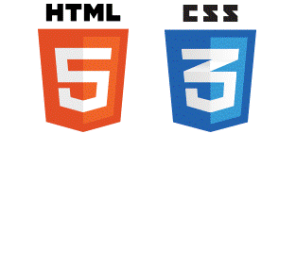



Architecture -
Web-based Application
Server
Client
GoogleAPI (places)
ROOK API
Server acts as the interface between the UI and Data Store.
APIs support rendering of information from the server to the UI.
Data Store

Slide 13
Architecture – Work Flow
Server
Client
Seller Login function {
Submit home function
Buyer recommendation function }
Seller Login Form
Property Listing Form
Buyer Login function {
Buyer search storing function
Property recommendation function }
Property search function{
Rent calculation function
Neighborhood score function
Property recommendation score function}
Buyer Login Form
Property Search Form

Slide 14
Functionality Seller Login
Seller Login Function
Property Details
Property details + house_id
Property details + house_id + neighborhood score
Submit Home Function
Property Details updated to Data Store
New Property details, List of Properties
Buyer Recommendation Function
Buyers id’s on Seller login page
New Property details, Buyers Data

Slide 15
Functionality Buyer Login
Buyer Login Function
Inputs for property search
Search Details + User_id
Buyer Search storing Function
User Details updated to Data Store
New User Details, List of Buyers
Property Recommendation Function
User id, List of relevant properties with recommendation score
Buyer search details, List of Properties
Property Search Function
Properties ordered with score
Buying recommendation score
Neighborhood score
Approximate rent income calculation
Properties matching
criteria
Buyer search details, List of Properties

Slide 16
Data Source - Simulated
Properties data – Details of properties posted by different sellers
Buyers data – details of buyers and their individual search details
Geographical information (City, Zone, Location)
Rental information at multiple levels (Zone, location name, property type, property level)
Location scores – simulated values

Slide 17
Future Work working app - we have restricted certain functionality
Function | Current feature/function in Application | Future development recommendation
Data store | Using file system | To be moved to Data base for scalability and robustness
Rental calculation | Using the static information | The rental should be calculated based on extracting statistics out of similar properties around the neighbourhood using geographical co-ordinates
Neighbourhood score | Using the selected places types for neighbourhood | The algorithm should be revisited, predictions has to be validated w.r.t reality.
Buying/Selling function | Currently the application covers only for selling or buying properties | Bringing rental option also into account
Predictive analytics | No predictive analytics is used other than complex lookup and averaging methods | The predictive analytics should be explored for the application (like recommender system, spatial models, conversion probability prediction).

Slide 18
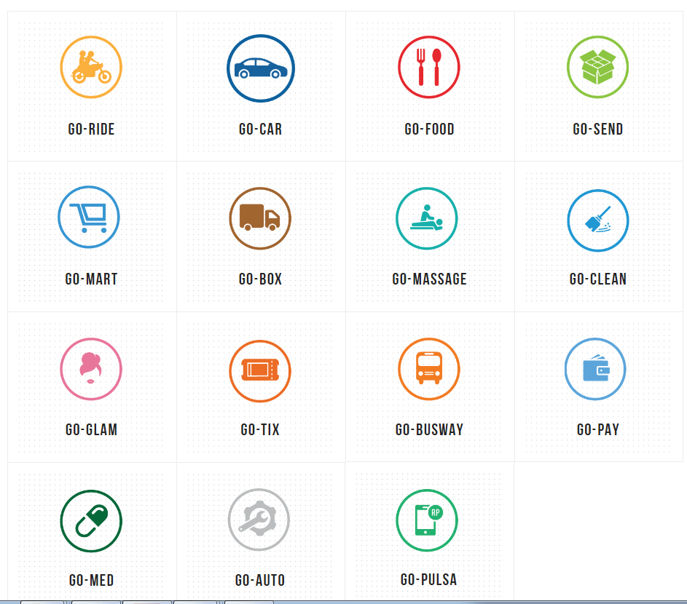
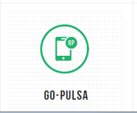


Future
GO-HOME

Slide 19
Thank you
SR-DreamHome
- Aap Ka Soch – Aap Ka Sapna Ghar
Rama Mohan Rao D
Sai Aravind Kashyap

